Slide 1

Bai Yuanqing,
Fu Xiaoxuan
Kuo Lunhsin
Srey Ponhvoan
Tan Rui Bin

Slide 2
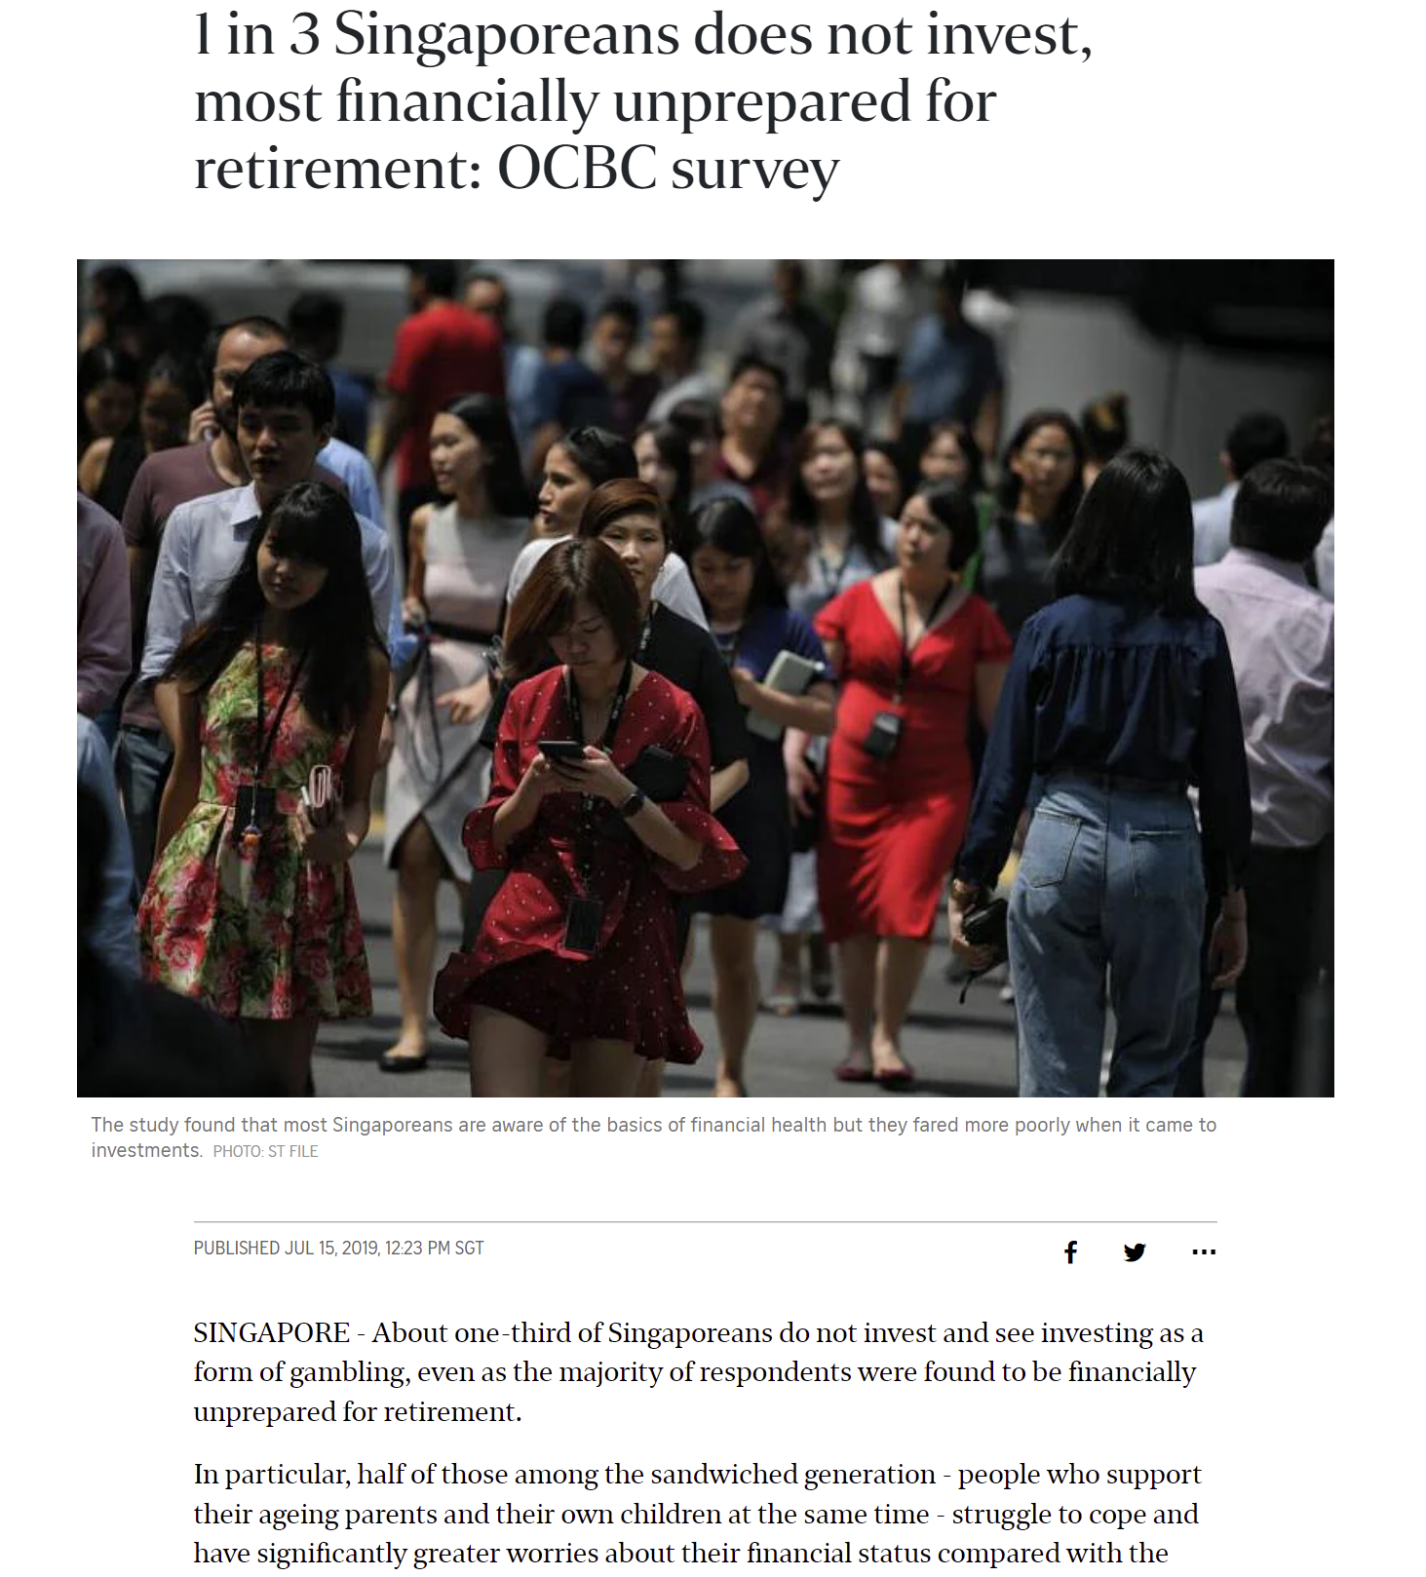
Problem Statement

Slide 3

Target & Goals
Independent investors: from beginners to moderate experience
All-in-one educational platform to consolidate information
Personalised matching to potential investments
Accessibility to financial consultant

Slide 4


Our Inspiration

Slide 5
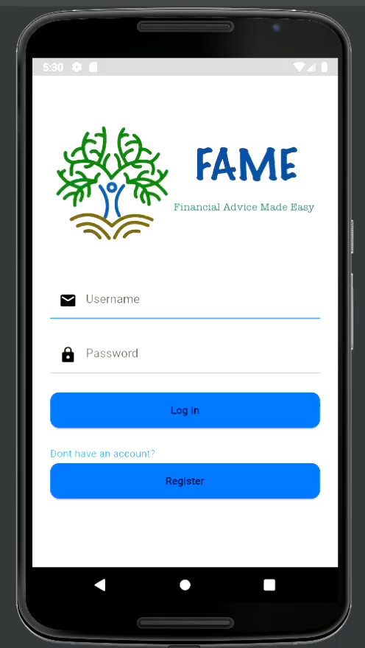
Introducing FAME

Slide 6
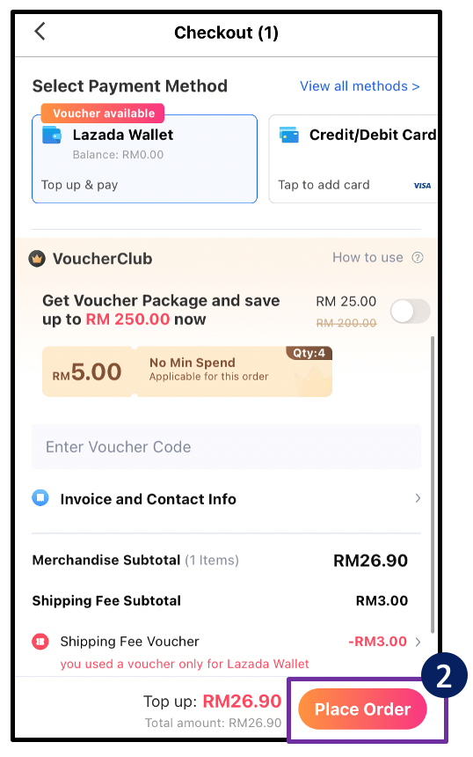
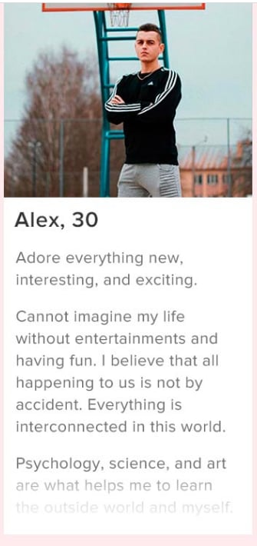
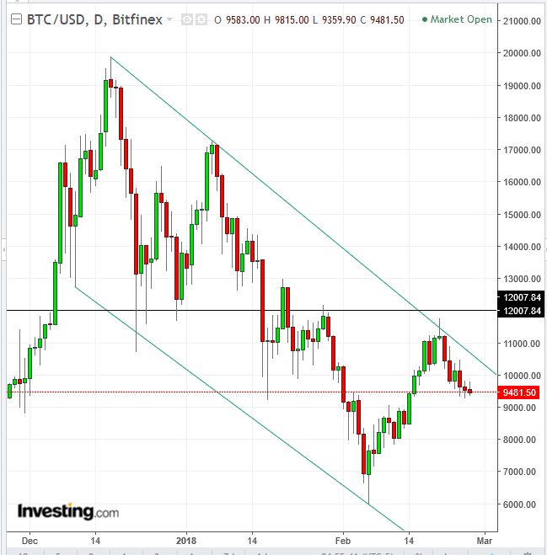
Future Developments
Free and unrestricted “bio”
More advanced checkout system
Information customised to user experience with investing

Slide 7
Thank You

